Slide 1

Bioavailability and Bioequivalence
Studies

Slide 2
Introduction
Essential to ensure uniformity in standards of quality, efficacy &
safety of Pharmaceutical products
Reasonable assurance is to be provided that various products
containing same active ingredient, marketed by different licensees
are clinically equivalent & interchangeable
Release of an active substance should be known & reproducible
Both Bioavailability & Bioequivalence focus on release of drug
substance from its dosage form & subsequent absorption in circulation
Similar approaches to measure Bioavailability should be followed in
demonstrating Bioequivalence

Slide 3
Bioavailability
Measurement of the relative amount & rate at which,
the drug from administered dosage form,
reaches the systemic circulation &
becomes available at the site of action
Bioavailable fraction (F), refers to the fraction of administered dose that enters the systemic circulation
F = Bioavailable dose
Administered dose

Slide 4
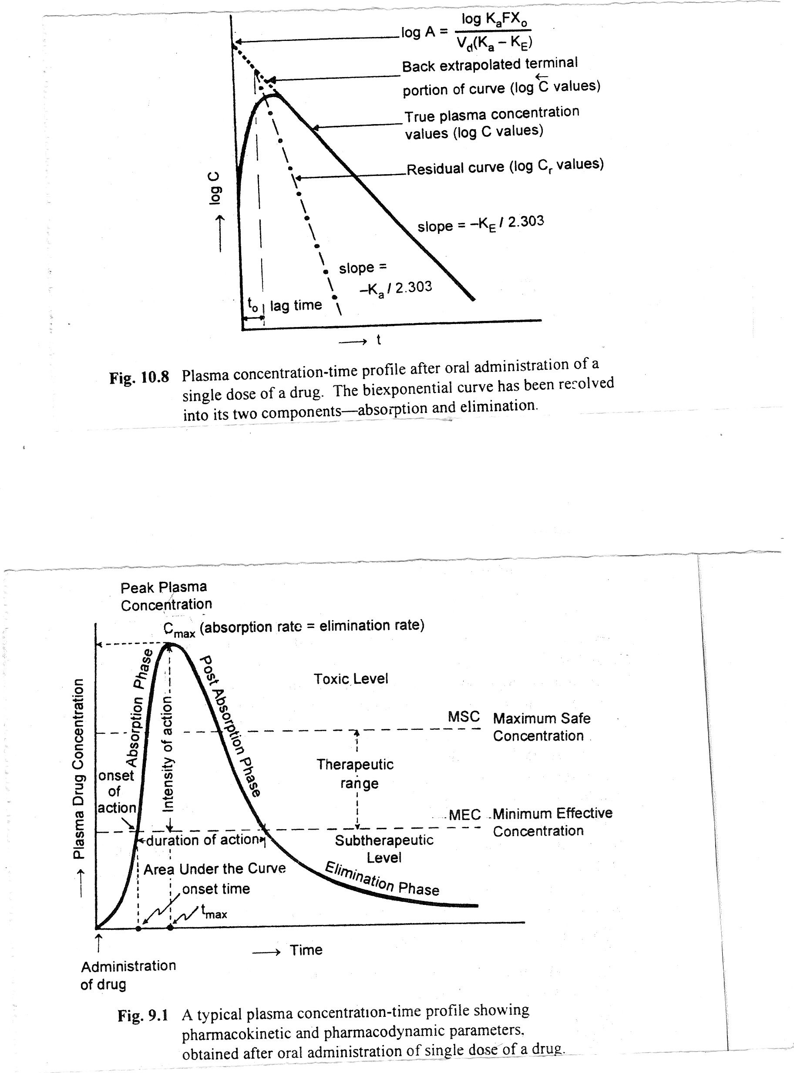
Therapeutic Relevance
Notes:
blood plasma or serum concentration usually expected to achieve desired therapeutic effects.
Extent of absorption is reflected by AUC; Rate of absorption, ka, is reflected by Tmax; Both Rate and Extent of absorption affect Cmax

Slide 5
Absolute Bioavailability
Compares the bioavailability of the active drug in systemic circulation following non-intravenous administration with
the same drug following intravenous administration
For drugs administered intravenously, bioavailability is 100%
Determination of the best administration route
F_{ab} = (AUC)_{drug}
(AUC)_{IV}

Slide 6
Relative Bioavailability
Compares the bioavailability of a formulation (A) of a certain drug when compared with another formulation (B) of the same drug, usually an established standard
F _{rel} = ( AUC) _{drug}
(AUC) _{standard}
Notes:
the process in which different chemical substances, including the active drug, are combined to produce a final medicinal product.

Slide 7
Factors affecting Bioavailability of a Drug
Physical properties of a drug
Physical state:
Liquids > Solids
[ Solution > Suspension > Capsule > Tablet > Coated tablet ]
Crystalloids > Colloids
Lipid or water solubility:
Aqueous phase at absorption site
Passage across Cell surface
Notes:
drug must be soluble in water in order to be absorbed; Transporters or lipid soluble

Slide 8
Dosage forms
Particle size:
Important for sparingly soluble drugs
↓ the size, ↑ the absorption, ↓ the dose
Nano-crystalline formulations of Saquinavir
If ↓ absorption needed (local action on GIT), ↑ the size
Notes:
Calcium, as well as food and dairy products containing high concentrations of calcium, may decrease the absorption of tetracyclines, phenytoin, due to chelate formation in the gut;

Slide 9
Physiological factors
Ionization:
Unionized form penetrates the GI mucosal lining quickly
pH of the fluid:
Weakly acidic drugs: Aspirin, Barbiturates→ Stomach, duodenum
Weakly basic drugs: Pethidine, Ephedrine→ Small intestine
Strongly acidic / basic drugs: highly ionized & poorly absorbed
Notes:
Disodium cromoglycate 2.0; Guanethidine 11.7; Meat from Curare killed animals was safe to eat as the drug is a highly ionized, strong base

Slide 10
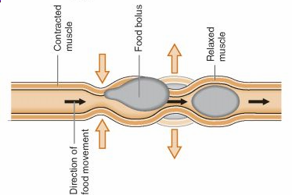
GI transit time
Prolonged gastric emptying:
Delays absorption due to stasis
(e.g. with anticholinergics / Diabetic neuropathy)
Increased peristaltic activity:
(e.g. Metoclopramide→ speeds up the absorption of analgesics)
Excessive peristaltic activity (as in Diarrhoea) impairs absorption
Fed state:
impairs progress of drug to intestine→ ↓ absorption (Indinavir)
↑ splanchnic blood flow→ ↑ absorption (Propranolol)
Notes:
Indinavir: a high-calorie, high-fat meal reduces plasma concentrations by 75%

Slide 11
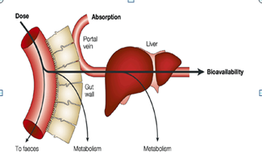
First pass metabolism:
Gut wall (e.g. Isoprenaline)
Liver (e.g. Opoids, ß-blockers, Nitrates)
Presence of other agents:
Vitamin C ↑ Iron absorption, Phytates retard it
Calcium ↓ absorption of Tetracyclines
Disease states:
Malabsorption, Achlorhydria, Cirrhosis, Biliary obstruction
can hamper absorption
Entero-hepatic cycling:
Increases bioavailability (e.g. Morphine, OC pills)

Slide 12
Concept of Equivalents
Pharmaceutical equivalents
equal amounts of the identical active drug ingredient,
(i.e. the same salt or ester of the therapeutic moiety)
identical dosage forms
not necessarily containing the same inactive ingredients
Pharmaceutical alternatives
identical therapeutic moiety, or its precursor
not necessarily the same:
salt or ester of the therapeutic moiety
amount
dosage form

Slide 13
Bioequivalence
Pharmaceutical equivalent / alternative of the test product,
when administered at the same molar dose,
has the rate and extent of absorption
not statistically significantly different from that of the reference
product
Therapeutic equivalence
Same active substance or therapeutic moiety
Clinically show the same efficacy & safety profile

Slide 14
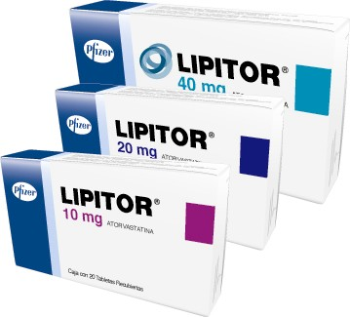
Reference Product
Identified by the Regulatory Authorities as
“Designated Reference Product”
Usually the Global Innovator’s Product
Protected by a patent
Marketed under manufacturers brand name
Clinical efficacy & safety profile is well documented in
extensive trials
All generics must be Bioequivalent to it
In India, CDSCO may approve another product as Reference product

Slide 15
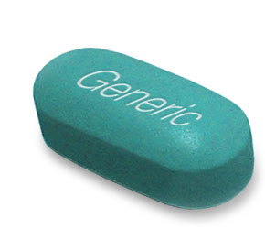
Generic Drug
Drug product which is identical or bioequivalent to Brand/ Reference
drug in:
Active ingredient (s)
Route of administration
Dosage form
Strength
Indications
Safety
May have different:
Inactive ingredients
Colour
Shape
Almost half of drugs in market have Generics
Notes:
An Abbreviated New Drug Application (ANDA) is an application for a U.S. generic drug approval for an existing licensed medication or approved dru

Slide 16
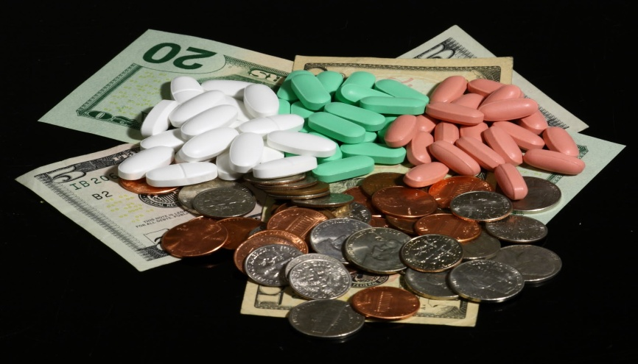
Price difference between Reference & Generic Drugs
Reference Drug | Generic Drug
Expensive | 30-80% cheaper
5/5000 new drug candidates tested in humans & 1 approved Takes 12-15 yrs Costs around 1 billion $ | Since already tested & approved, cost of simply manufacturing Fraction of the cost of testing & development
Drug Patents of 20yrs, applied before clinical trials begin Effectively 7-12 yrs | Approved for sale after drug patent protection expires

Slide 17

Fundamental Bioequivalence Assumption
When a generic drug is claimed bioequivalent to a
Reference drug, it is assumed that they are
therapeutically equivalent
Notes:
The United States Food and Drug Administration (FDA) bans the import of more than 30 generic drugs made by Indian drug firm Ranbaxy. FDA found “manufacturing quality problems” at two of Ranbaxy's factories in India.

Slide 18
Bioequivalence Background
Using bioequivalence as the basis for approving generic copies in US
“Drug Price Competition and Patent Term Restoration Act of 1984,” also known as the Waxman-Hatch Act
Created Generic Industry & ↑ their availability
Most successful legislation
Benefited Brand & Generic firms
Generic firms→ Rely on findings of safety & efficacy of Innovator drug after Patent expiration
Innovator firms→ Patent extensions of 5yrs to make up for time lost while their products were going through FDA's approval process

Slide 19
Indian Legislation
In India, CDSCO provides “Guidelines for Bioavailability &
Bioequivalence Studies” mentioned in Schedule Y
As per the Drugs & Cosmetic Rules (IInd Amendment) 2005,
all bioavailability and bioequivalence studies should be conducted
in accordance to these Guidelines
Notes:
2 Manufacturing plants not as per US-FDA standards for 50 drugs

Slide 20
Requirement of BA & BE Studies
For IND/NDAs:
To establish equivalence between:
Early & late clinical trial formulations
Formulations used in clinical trial & stability studies
Clinical trial formulations & to-be-marketed drug product
Any other comparisons, if appropriate
ANDA for a generic drug product
Change in components, composition, &/or manufacturing process
Change in dosage form (capsules to tablet)
Notes:
New method/formulation is test, earlier is reference

Slide 21
Objectives of BA & BE Studies
Development of suitable dosage form for a New Drug Entity
Determination of influence of excipients, patient related factors &
possible interactions with other drugs
Development of new drug formulations of existing drugs
Control of quality of drug products, influence of →
processing factors, storage & stability
Comparison of availability of a drug substance from different form
or same dosage form produced by different manufacturers

Slide 22
When is Bioequivalence not necessary (Biowaivers)
Parental Solution; same active substance with same concentration, same excipient
Oral Solution; same active substance with same concentration, excipient not affecting GI transit or absorption
Gas
Powder for reconstitution as solution; meets criterion (a) or (b)
Otic/Ophthalmic/Topical Solution; same active substance with same concentration, same excipient
Inhalational Product/ Nasal Spray; administered with or w/o same device as reference product ; prepared as aqueous solution ; same active substance with same concentration, same excipient

Slide 23
NDA vs ANDA Review Process
NDA Requirements ANDA Requirements
1. Chemistry 1. Chemistry
2. Manufacturing 2. Manufacturing
3. Controls 3. Controls
4. Labeling 4. Labeling
5. Testing 5. Testing
6. Animal Studies
7. Clinical Studies 6. Bioequivalence
8. Bioavailability

Slide 24
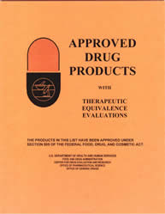
Orange Book
All FDA approved drugs listed
(NDA’s, ANDA’s & OTC’s)
Expiration of patent dates
Drug, Price and Competition Act (1984)
FDA required to publish Approved Drug Products with
Therapeutic Equivalence & Evaluations

Slide 25
Methods used to assess Equivalence
Pharmacokinetic Studies
Pharmacodynamic Studies
Comparative Clinical Studies
Dissolution Studies

Slide 26
Pharmacokinetic Studies

Slide 27
Study Design
Good experimental design, enhances the power of the study
Depends on: question to be answered, nature of reference
drug/ dosage form, benefit-risk ratio
As far as possible, the study should be of crossover design &
suitably randomized
Ideal design: Randomized two-period, two-sequence,
Crossover design with adequate washout period
If the half-life is long: Parallel design
For highly variable drugs: Replicate design
Any drug whose rate and extent of absorption shows large dose-to-dose variability within the same patient
Notes:
HVD or medicinal products which show high inter occasional variability: CV > 30%. atorvastatin, esomeprazole, pantoprazole, clarithromycin

Slide 28
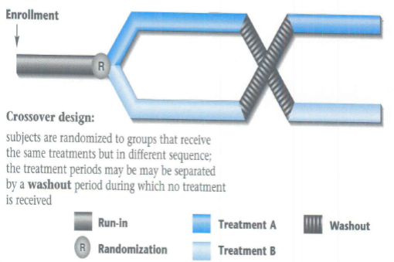
Two-Period Crossover Design
2 formulations, even number of subjects,
randomly divided into 2 equal groups
First period , each member of one group receive a single dose of the test formulation; each member of the other group receive the standard formulation
After a wash period (5 half lives), in second period , each member of the respective groups will receive an alternative formulation & experiment will be repeated.
Subjects | Period 1 | Period 2
1-8 | T | S
9-16 | S | T

Slide 29

Latin Square Design
More than two formulations
A group of volunteers will receive formulations in the sequence
shown

Slide 30
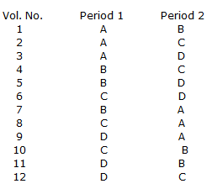
Balance Incomplete Block Design (BIBD)
More than 3 formulations, Latin square design will not be ethically
advisable
Because each volunteer may require drawing of too many blood
samples
If each volunteer expected to receive at least two formulation,
then such a study can be carried out using BIBD
Notes:
if there are four formulations, six possible pairs or formulations can be chosen from four formulations. Then, the first 6 volunteers will receive these six pairs formulations and the next six volunteers will receive the same six pairs in reverse order.

Slide 31
Parallel-Group Design
Even number of subjects in two groups
Each receive a different formulation
No washout necessary
For drugs with long half life
Treatment A | Treatment B
1 | 2
3 | 4
5 | 6
7 | 8
9 | 10
11 | 12

Slide 32
Parallel | Crossover
Groups assigned different treatments | Each patient receives both treatments
Shorter duration | Longer duration
Larger sample size | Smaller sample size
No carryover effect | Carryover effect
Doesn’t require stable disease & similar baseline | Requires stable disease & similar baseline

Slide 33
Replicate Crossover-study design
For highly variable drugs
Allows comparisons of within-subject variances
Reduce the number of subjects needed
Four-period, two-sequence, two-formulation design (recommended)
OR
Three-sequence, three-period, single-dose, partially replicated
Period | 1 | 2 | 3
Group 1 | T | R | T
Group 2 | R | T | R
4
R
T

Slide 34
Pilot Study
If the sponsor chooses, in a small number of subjects
To assess variability, optimize sample collection time intervals
& provide other information
Example:
Immediate-release products: careful timing of initial samples→
avoid a subsequent finding that the first sample collection,
occurred after the plasma concentration peak
Modified-release products: determine the sampling schedule →
assess lag time & dose dumping
Can be appropriate, provided its design & execution are suitable &
sufficient number of subjects have completed the study

Slide 35
Subject selection
Healthy adult volunteers
Age: 18-45 yrs
Age/Sex representation corresponding to therapeutic & safety profile
Weight within normal limits→ BMI
Women: Pregnancy test prior to 1st & last dose of study; OC pills C/I
Drug use intended in Elders (Age >60yrs)
Teratogenic Drugs→ Male volunteers
Highly toxic drugs: Patients with concerned disease (stable) eg. Cancer

Slide 36
Exclusion Criteria
allergy to test drug
liver or kidney dysfunction
jaundice in past 6 months
Chronic diseases eg. Asthma, arthritis
Psychiatric illness
Chronic smoker, alcohol addiction, drug abuse
Intake of enzyme modifying drug in past 3 months
Intake of OTC/Prescription drugs past 2 weeks
HIV positive
BA & BE studies in past 3 months
bleeding disorder

Slide 37
Selection of Number of Subjects
Sample size is estimated by:
Pilot experiment
Previous studies
Published data
Minimum 16 subjects, unless ethical justification
Allow for drop-outs
Replace drop-outs→ substitute follow same protocol;
similar environment
Sequential/ Add-on Studies→ large no. of subjects required, results of study do not convey adequate significance

Slide 38
Genetic Phenotyping
Drug is know to be subject to genetic polymorphism
Cross-over design→ Safety & Pharmacokinetic reasons
All Parallel group design
Indian population:
Captures genetic diversity of the world
Forms continuum of genetic spectrum
>1000 medically relevant genes
Diverse patient/ volunteer pool for conducting BA & BE studies
Notes:
Different rates of metabolism: subtherapeutic or toxicities

Slide 39
Characteristics to be measured
Accessible biological fluids like blood, plasma &/or serum
to indicate release of the drug substance from the drug
product into the systemic circulation
Mostly: Active drug substance
Active / Inactive metabolite maybe measured in cases of:
Concentration of drug too low
Limitation of analytical method
Unstable drug
Drug with very short half life
Pro-drugs
Excretion of drug & its metabolites in urine→ Non-linear kinetics

Slide 40
Measure individual enantiomers when they exhibit:
Different pharmacokinetic/ pharmacodynamic properties
Non-linear absorption
Safety/Efficacy purposes
Drugs that are not absorbed systemically from site of application
surrogate marker needed for BA & BE determination

Slide 41
Surrogate Markers
Drug product | Drug | Possible surrogate marker for bioequivalence
Topical steroid | Hydrocortisone | Skin blanching (skin becomes white or pale in appearance. )
Anion exchange resin | Cholestryamine | Binding to bile acids
Antacids | Mg & Al hydroxide gel | Neutralization of acid
Topical antifungal | Ketoconazole | Drug uptake into stratum corneum

Slide 42
Blood Sampling points/ Schedule
Single-dose study of an immediate release product:
For at least three elimination half-lives (cover >80% of AUC)
Absorption phase : 3-4 points
Around T_{max} : 3-4 points
During elimination : 4 points
Intervals not longer than the half-life of the drug
If urine tested, collect it for at least 7 half-lives

Slide 43
Method Validation
Accuracy/ Relative Recovery
Closeness of determined value to the true Value
Precision
Closeness of agreement obtained from the multiple sampling of the same homogeneous samples under certain prescribed conditions
Repeatability
Precision under same conditions
same analyst, same apparatus, same interval of time, identical reagents
Reproducibility
Precision under different conditions
different analysts, apparatus from different manufacturers,
different days, reagents from different sources
Notes:
Accuracy (Relative Recovery) expresses the closeness of agreement between the value which is accepted either as a conventional true value or an accepted reference value and the observed value found by using the method for quantitation

Slide 44
Sensitivity
Capacity of the test procedure to record small variations in concentration
Limit of detection (LOD):
Lowest concentration of drug that will yield an assay response significantly different from that of a sample blank
Limit of quantitation (LOQ/ sensitivity limit):
Lowest concentration of drug that can be determined with acceptable precision & accuracy under the stated experimental conditions
Selectivity/ Specificity
Ability of the method to measure only what it is intended to measure
Notes:
in the presence of other components in the sample
All values below the limit of quantification were considered as zero for the computation of pharmacokinetic parameters and statistical calculations

Slide 45
Calibration of Instruments
Should be done regularly & as per standard procedures in
USP/BP/IP
Done before starting the analysis at the development phase &
during the study phase
Predetermined SOPs
Accreditation of analyzing laboratory

Slide 46
Parameters to be measured
Pharmacokinetic Parameters measured are:
C_{max}
T_{max}
AUC_{0-t}
AUC_{0-∞}
For steady state studies:
AUC_{0-t}
C_{max}
C_{min}
Degree of fluctuation
AUC _{0-∞} = AUC _{0-t} + C_{last} /k
Notes:
The elimination rate constant (Ke) was obtained from the least-square fitted terminal loglinear portion of the serum concentration-time profile

Slide 47
Fasting & Fed State Conditions
Fasting Conditions:
Single dose study:
Overnight fast (10 hrs) and subsequent fast of 4 hrs
Multiple dose study:
Two hours fasting before and after the dose

Slide 48
Fed State Studies
Required when:
Drug recommended with food
Modified release product
Assessment of C_{max} and T_{max} difficult with fasting state study
Requires consumption of a high fat food, 15 minutes before dosing
Provide 950-1000 kcals
Fat- 50%, Proteins 15-20%, Carbohydrate- 30-35%
Ethnic & cultural variation considered
Specified in protocol

Slide 49
Steady State/ Multiple Dose Studies
Long elimination half life→ Accumulation in the body
Toxic drugs requiring multiple dose therapy
Some Modified-release drugs
Combination products
Drugs inducing own metabolism
Drugs showing non-linear pharmacokinetics

Slide 50
Disadvantages:
Difficult to conduct
Costly
Longer monitoring
Longer exposure to drug
Notes:
Due to saturation of absorption, distribution, metabolism, excretion

Slide 51
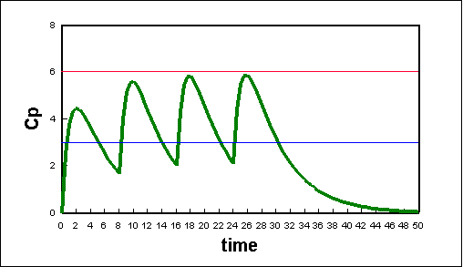
Parameters in Multiple dosing studies
C_{max}ss
AUCss
C_{min}ss
Fluctuation: C_{max} - C_{min}
Notes:
Swing: (Cmax - Cmin)/Cmin

Slide 52
Statistical Evaluation
Primary concern of bioequivalence is to limit Consumer’s &
Manufacturer’s risk
C_{max} & AUC analyzed using ANOVA
T_{max} analyzed by non-parametric methods
Use natural log transformation of C_{max} and AUC
Calculate Geometric means of C_{max} of Test [C_{max}’t]
Calculate Geometric means of C_{max} of Reference [C_{max}’r]
Calculate Geometric Mean Ratio= [C_{max}’t] / [C_{max}’r]
Calculate 90% confidence interval for this GMR for C_{max}
Similarly calculate GMR for AUC
Notes:
Log transformation decreases the variability & converts the values in a normally distributed format

Slide 53
To establish BE:
The calculated 90% CI for C_{max} & AUC, should fall within range:
80-125% (Range of Bioequivalence)
Non-parametric data 90% CI for T_{max} should lie within
clinical acceptable range

Slide 54
BE Results
Demonstrate BE
Fail to Demonstrate BE
Demonstrate BE
Fail to Demonstrate BE
Fail to Demonstrate BE
80%
T/R (%)
125%

Slide 55
Tighter limits may be required for drugs which have:
A narrow therapeutic index
A serious dose-related toxicity
A steep dose-response curve
Non-linear pharmacokinetics within therapeutic range
Wider range maybe acceptable, based on sound clinical justification
Suprabioavailability
New product displays an extent of absorption,
larger than approved product
Reformulation to lower dosage f/b fresh BA & BE study
Otherwise, clinical data required

Slide 56
Modified-release drug products
Drug release characteristics of time course &/or release location
Chosen to achieve therapeutic &/or convenience objectives not
offered by immediate release forms
Includes:
Delayed release
Sustained release
Mixed immediate & sustained release
Mixed delayed & sustained release
Mixed immediate & delayed release

Slide 57
Should meet following criteria:
Meet the label claims
Preclude any dose-dumping
Provide therapeutic equivalence with:
Multiple doses of reference product
OR
Reference modified release formulation
Produce plasma levels within therapeutic range

Slide 58
Study Design for Modified Release formulation
Unlikely to accumulate:
First market entry
Comparison between Single dose of Modified release preparation &
Immediate release formulation as per established dose regimen
Subsequent market entry
Comparison with Reference Modified release product
Likely to accumulate:
Both single & steady state doses of Modified Release formulation
compared with immediate release formulation as per established
dose regimen

Slide 59
Effect of food:
Not known/ Known that food affects absorption:
Two way cross over studies both in Fasting & Fed state
Known that it not affected by food:
Three way cross over study done with
Reference product in Fasting state
Test product in Fasting state
Test product in Fed state

Slide 60
Conduct of Study
Pre-study Requirements
IEC approved protocol
Written procedure (SOPs) for all the study related activities
In accordance with ICH-GCP Guidelines
Adequate infrastructure- Clinical facility
Trained Study personnel
Healthy Volunteers
Notes:
ECG, Defibrillator, Ambulance, Reference centre; PI, CRCs

Slide 61
Screening of Healthy volunteers
Recruitment through advertisements
Written consent for Screening & Consent for HIV testing
Height & weight
Medical History
Physical examination, ECG & vital signs examination
Blood & Urine sample
(Lab testing,; tests for HIV, Hepatitis A, B & C; UPT→ females)

Slide 62
Volunteer Selection & Recruitment
Volunteers called 1 day before study & admitted
Written ICF taken
During the Study
Standardized study environment
Vital signs examination at scheduled times
Standardized amount of water [~240ml]
No concomitant medications [including herbal remedies]
Notes:
before dosing

Slide 63
Administration of the study medication is supervised by the
investigator
Same time of dosing (multiple dosing)
Sampling time with deviation of 2 mins allowed
Uniform & identical meals at identical times in all periods
Restriction of xanthines, grapefruit, citrus fruits, smoking, alcohol
Physical activity & posture standardized→
limit effects on GI flow & motility
All activities recorded in CRFs with time & date
Notes:
to ensure that the drug had been swallowed, followed by a mouth check to verify the compliance of the volunteers
10.0 mL blood sample for the ibuprofen assay were drawn into tubes through an indwelling cannula

Slide 64
End of Study
Post-study examination for safety assessment
Compensation to subjects as per agreed terms
Clinical part of study completed

Slide 65
Documentation
Signed detailed protocol
Approval by Ethics Committee
Volunteer Information sheet
Informed Consent Form (ICF)
Case Record Form (CRF)
Undertaking by investigator
CV of investigator
Randomization chart
Laboratory certification
Analytical method validation details
Chromatograms of all volunteers including any aberrant ones
Tabulated Raw Data of volunteers
Notes:
Intra and inter assay results

Slide 66
Maintenance of Records & Retention of Study Samples
All Records of in vivo tests on any marketed batch of a
drug product should be maintained by the Sponsor
for atleast 2 years after expiry date of the batch
All Drug samples to be retained for a period of atleast
3 years after conduct of the study
OR
1year after expiry of the batch
[Stored in conditions consistent with the product labeling]

Slide 67
Pharmacodynamic
Studies

Slide 68
Measurement of effect on a Patho-physiological process
as a function of time, after administration of 2 different products
Necessity:
Quantitative analysis in plasma or urine not possible with
sufficient accuracy & sensitivity
Drug concentrations are not surrogate endpoints
e.g. Topical formulations without systemic absorption
In situations of ‘Superiority Claims’
In case only Pharmacodynamic data is collected→
other methods tried & why they were unsuitable

Slide 69
Special considerations while conducting this study:
Response measured→ Pharmacological/ Therapeutic effect→
relevant to Efficacy/ Safety of drug
Methodology validated→ Precision, accuracy, reproducibility, specificity
Neither should produce a maximal response→
not possible to distinguish differences between formulations
given in those doses
Response measured “quantitatively” under double-blind conditions,
on repetitive basis, to record pharmacodynamic events→
Pharmacodynamic effect curve
Eg: Heart rate, pupil diameter, BP

Slide 70
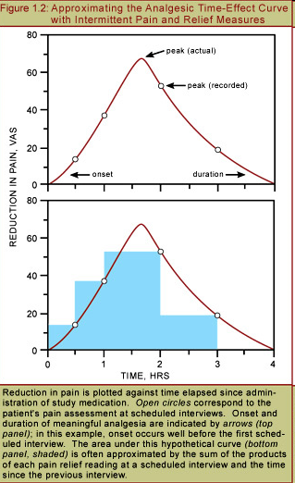
Parameters studied:
Area under the curve
Maximum response
Time for maximum response

Slide 71
Non Responders excluded by prior screening
If Placebo effect can occur→ 3rd Stage with Placebo treatment in study design
In Patients→ Underlying Pathology & Natural-history considered
Conventional acceptance range → defined in protocol,
case to case basis

Slide 72
Comparative Clinical Studies

Slide 73
Necessity:
Both pharmacokinetic & pharmacodynamic parameters
not properly measurable or not feasible
Mention which methods were tried & found unsuitable
Statistical principles to be considered:
No. of patients→ Variability of assessed parameters & acceptance range
Much higher than BE studies

Slide 74
Following critical points need to be defined in advance,
on case to case basis:
Clinical end points (Target parameters)→ intensity & onset of response
Size of equivalence range→ case-to-case basis
(depending on natural course of disease, efficacy of available treatments,
target parameter)
Statistical confidence interval approach:
one-sided interval→ rule out inferiority
Placebo included when appropriate
Safety end-points in some cases

Slide 75
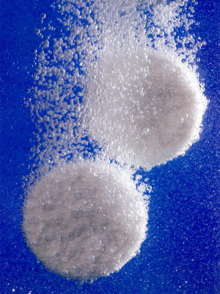
Dissolution Studies

Slide 76
Suitable to confirm unchanged product quality with minor changes in formulation / manufacturing after approval→
SUPAC ( Scale-Up & Post-Approval Changes)
Different strengths of drug manufactured by same manufacturer
where:
Qualitative composition is same
Ratio of active ingredients & excipients is same
Method of manufacture is same
BE study has been performed on 1 strength
Linear pharmacokinetics
Signal of bio-inequivalence
Assess batch-to-batch quality
More than 1 batch of each formulation tested
Notes:
Comparative dissolution profile instead of single point dissolution test data

Slide 77
Design should include:
Individually testing of atleast 12 dosage units of each batch →
Mean & Individual results with Sd or SE
Measurement of percentage of content released at suitably spaced
time points
(eg. At 10, 20 & 30 mins or appropriate for complete dissolution)
Dissolution profile in atleast 3 aqueous media with pH range of
1.0-6.8 Or 1.0-8.0 wherever necessary
Conduct tests on each batch with same apparatus & on same or
consecutive days

Slide 78
Dissolution testing should be carried out in:
USP Apparatus I at 100 rpm or Apparatus II at 50 rpm
using 900 ml of the following dissolution media:
0.1N HCl or Simulated Gastric Fluid USP without enzymes
a pH 4.5 buffer
a pH 6.8 buffer or Simulated Intestinal Fluid USP without enzymes
For capsules and tablets with gelatin coating
Simulated Gastric and Intestinal Fluids USP (with enzymes)
can be used

Slide 79
Advantages offered
Reduced costs:
Data anticipates Bioequivalence
Type II error ++ for PK studies
More direct assessment:
If complicated in-vivo assessment
Ethical benefit:
No unnecessary human study

Slide 80


